Slide 1



ZIDS GAMING STORE
Gafrilatif Aviandi Putra Adnanta
Muhamad Farhan Budiana
Muhammad Zidan Satrio

Slide 2

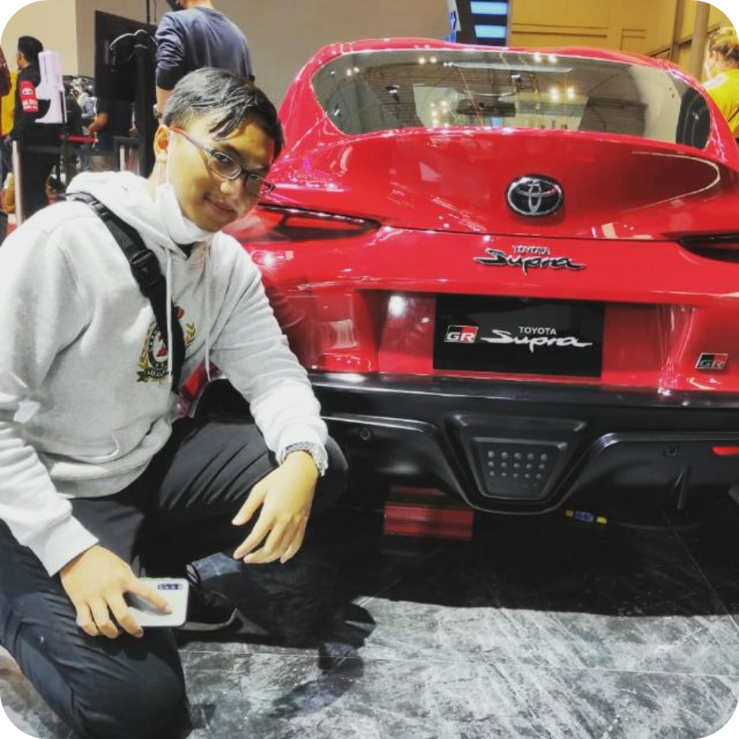
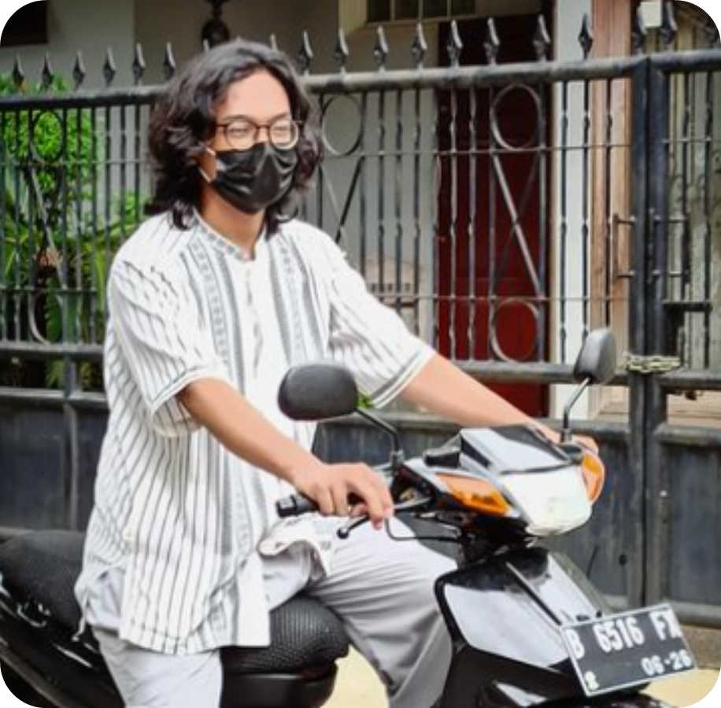

PRESENTED BY
Gafrilatif Aviandi Putra
Project Leader
Muhamad Farhan Budiana
Muhammad Zidan Satrio

Slide 3

THE TOOLS WE USED IN OUR PROJECT
Scenario Manager
Chart
Product
Vlookup
Sparkline
Trendline
PMT
Future Value
Sum and Average
Min and Max
Protection
Pivot Table
Power Pivot
IF Function
Define Name

Slide 4
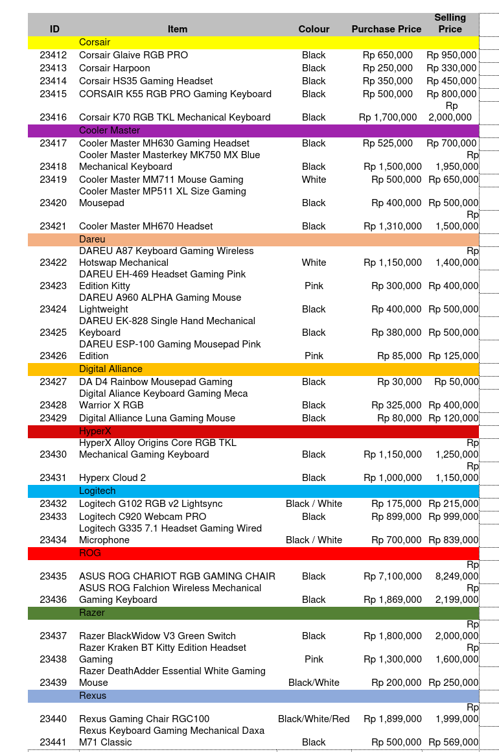

OUR MAIN ITEMS IN ZIDS GAMING STORE

Slide 5

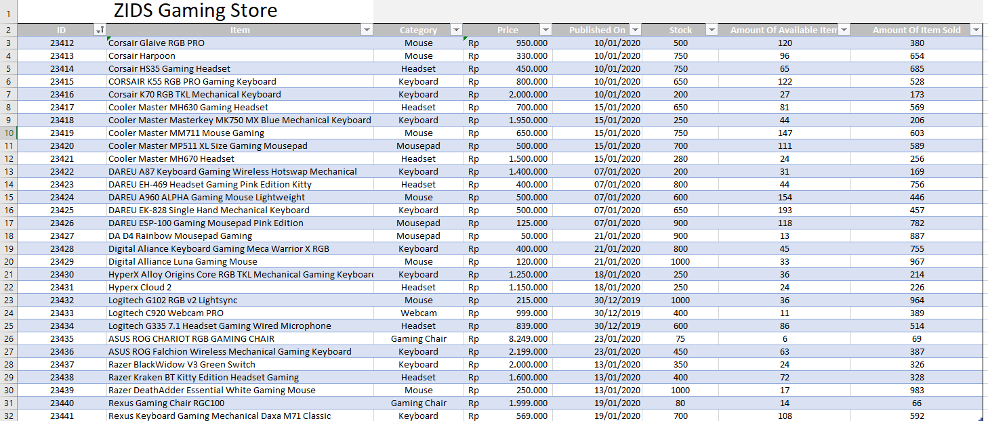
Stocks (Available and Sold out )

Slide 6
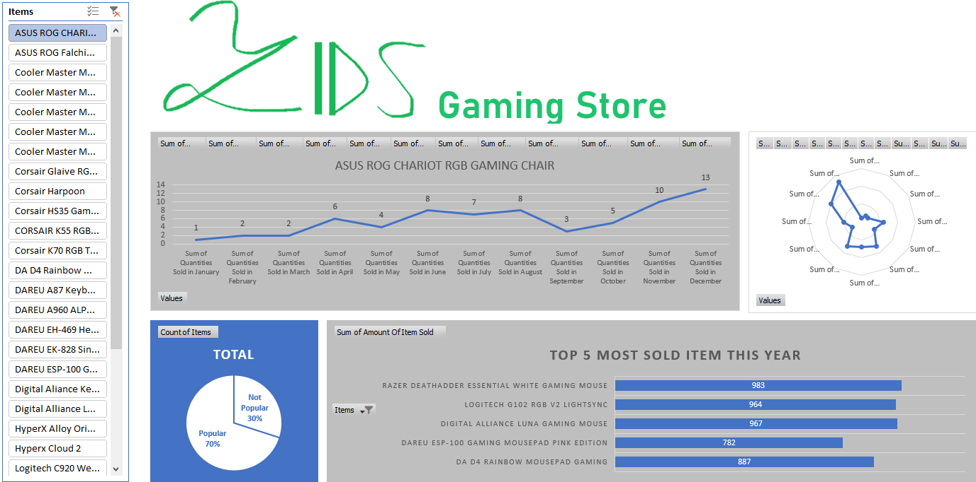
Dashboard

Slide 7
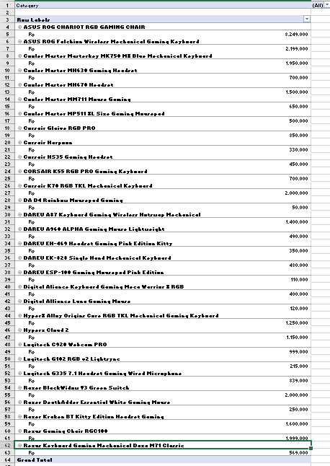

Pivot Table of Items

Slide 8
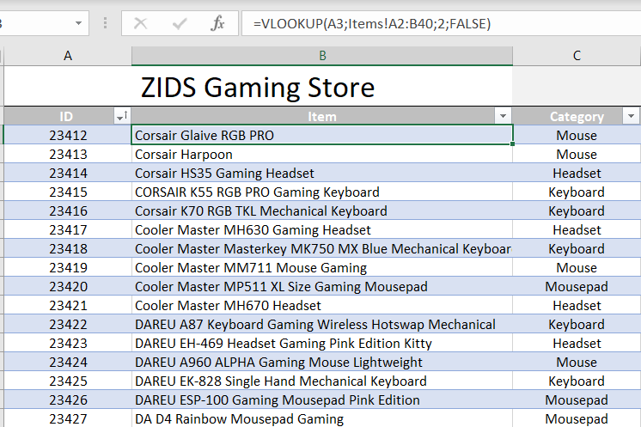
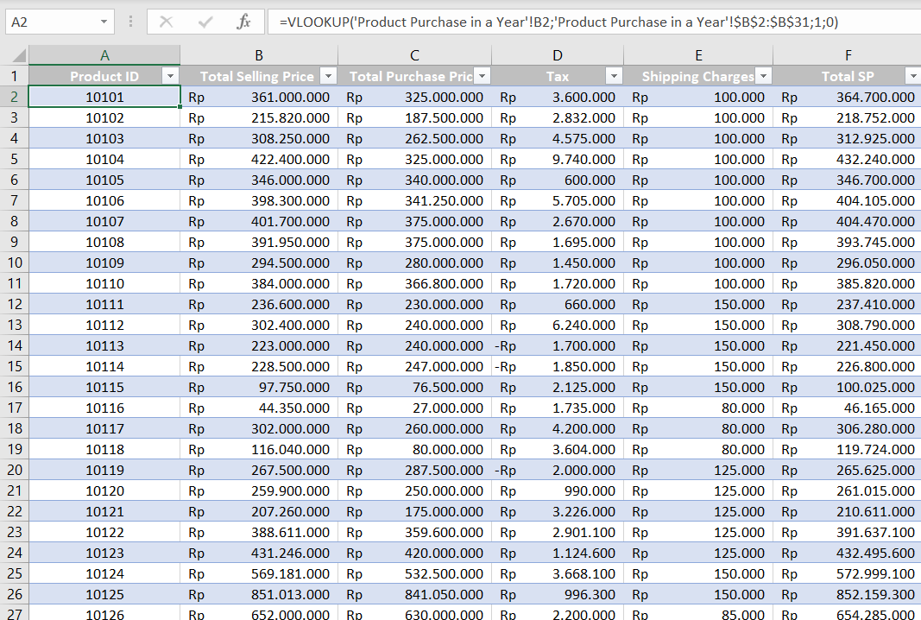
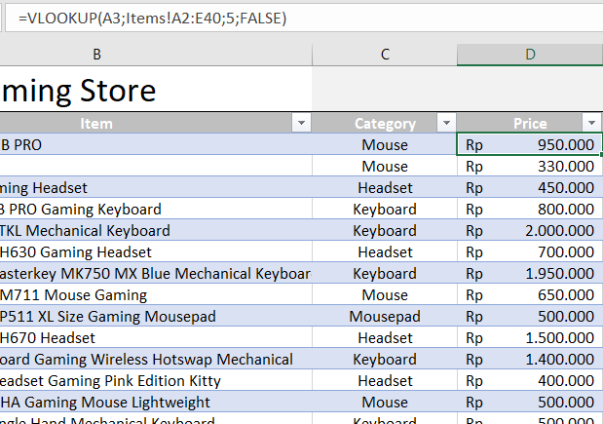
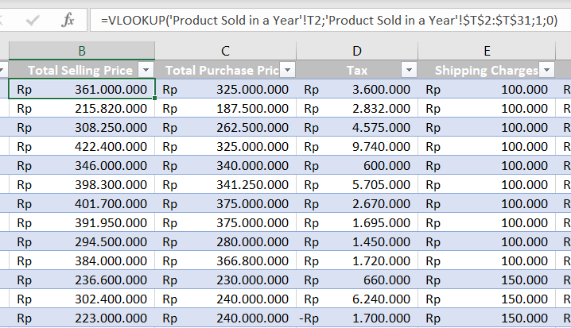
VLOOKUP

Slide 9
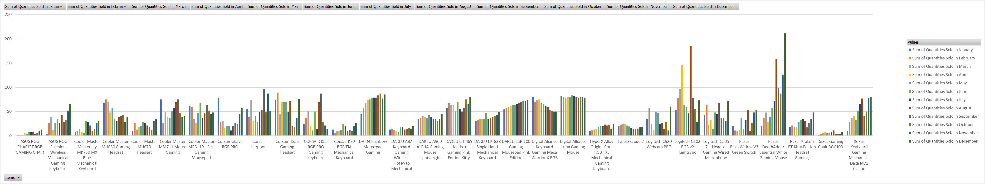

Chart

Slide 10
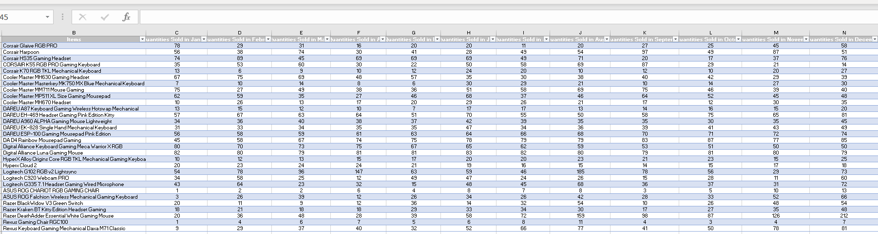
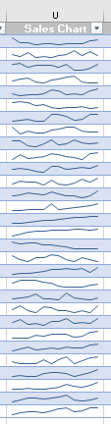

Sparkline

Slide 11
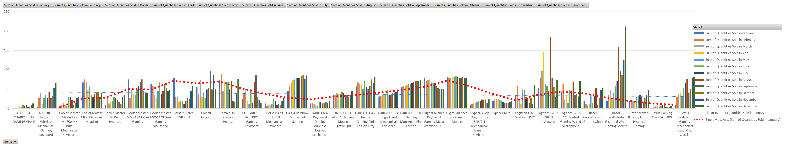

Trendline

Slide 12
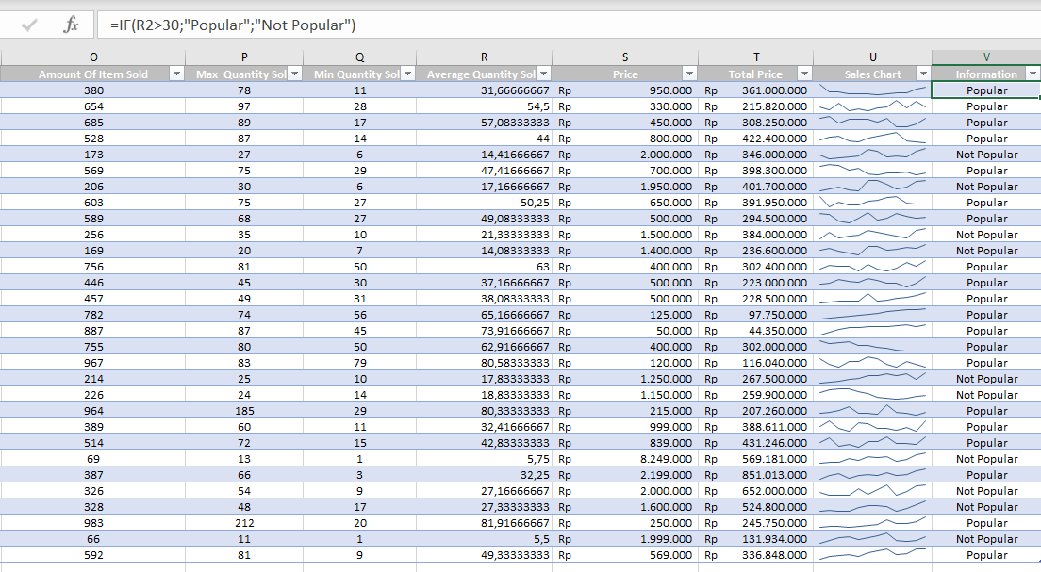
IF Function

Slide 13
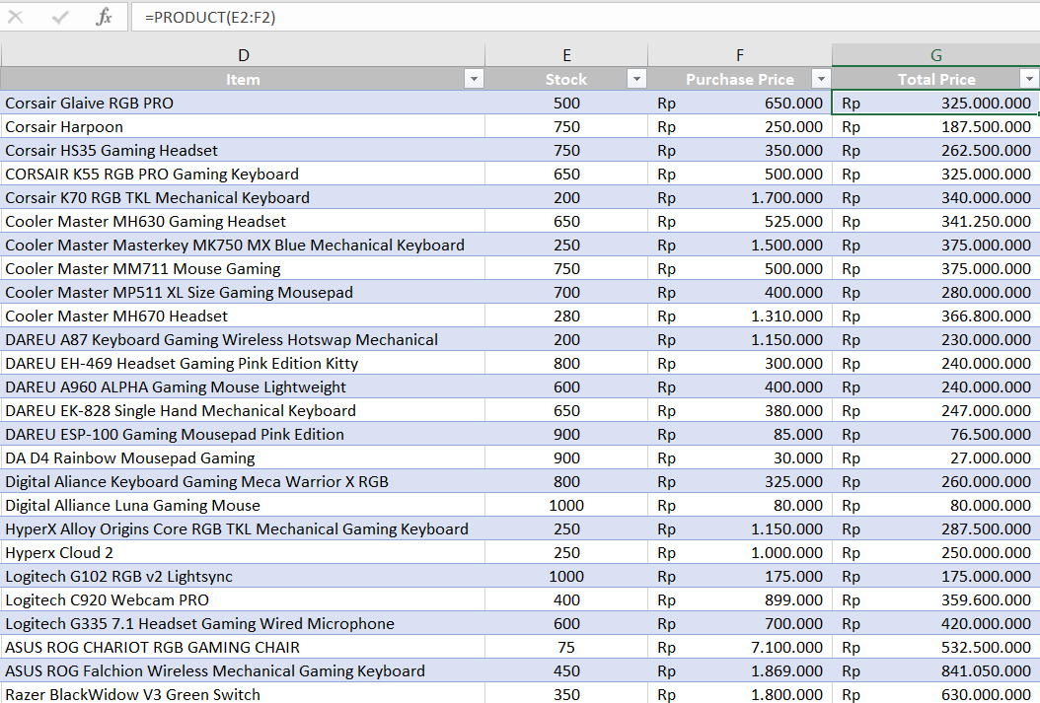
Product

Slide 14
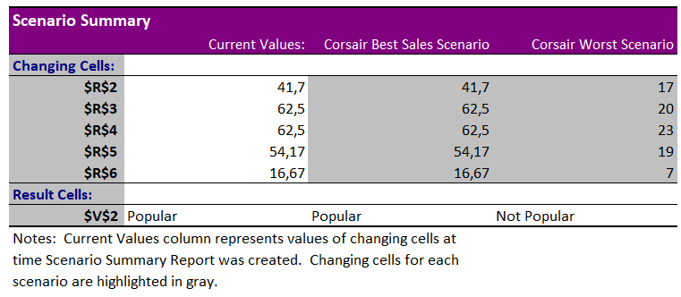
Scenario Manager

Slide 15
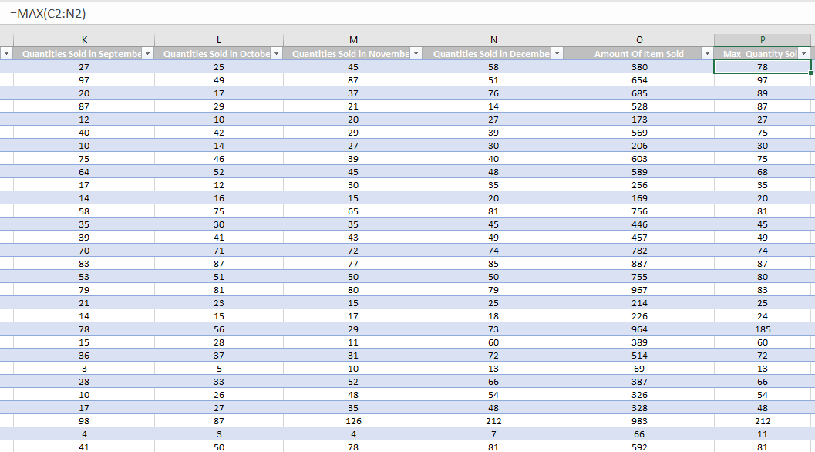
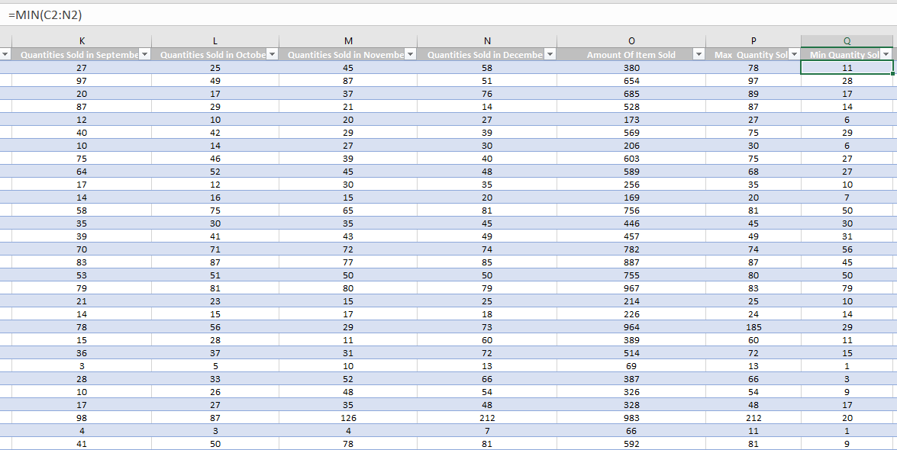
Max Quantity
Min Quantity

Slide 16
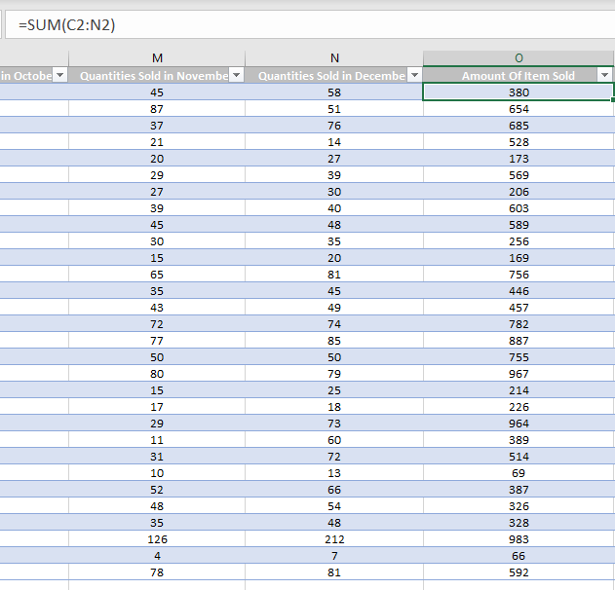
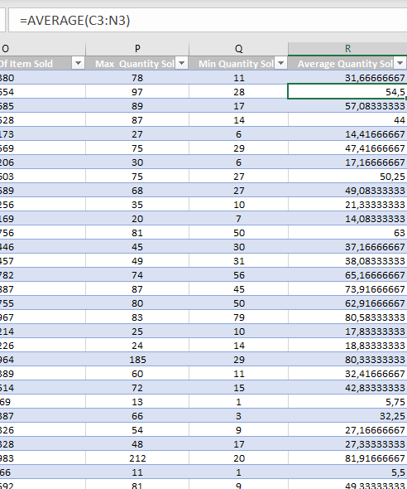
Sum
Average

Slide 17
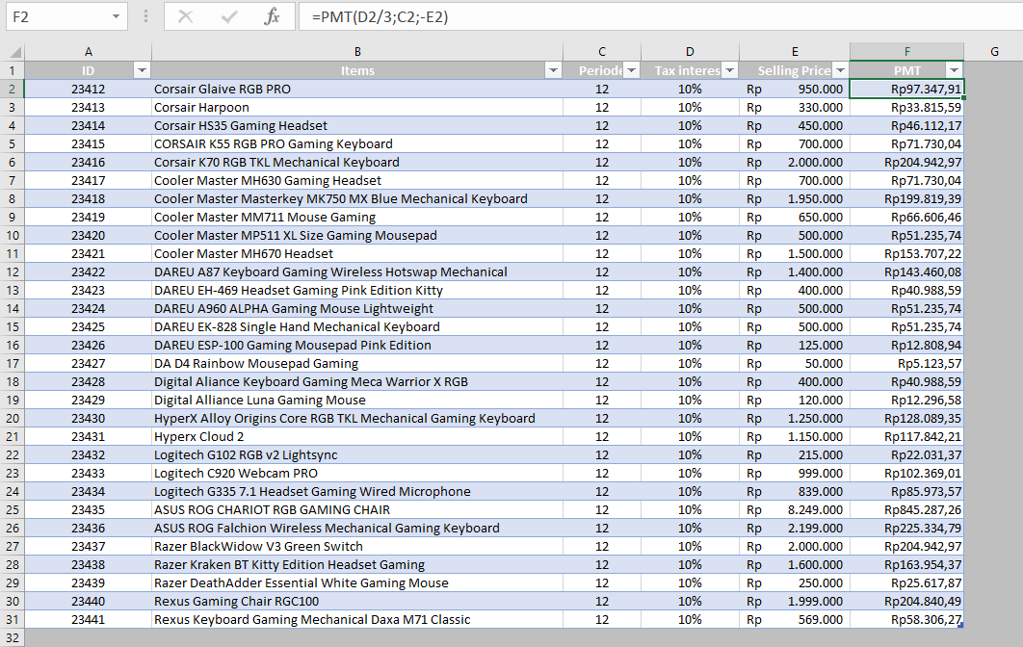
PMT

Slide 18
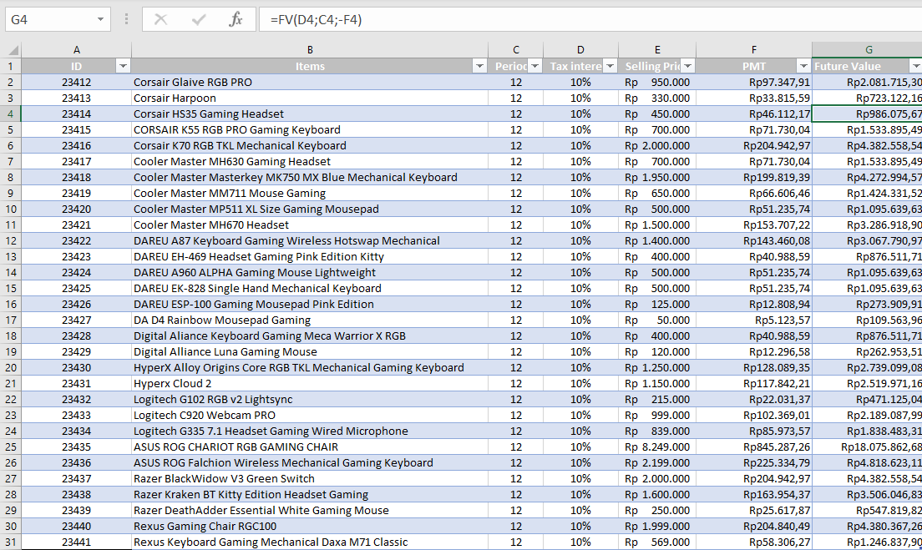
Future Value (FV)

Slide 19
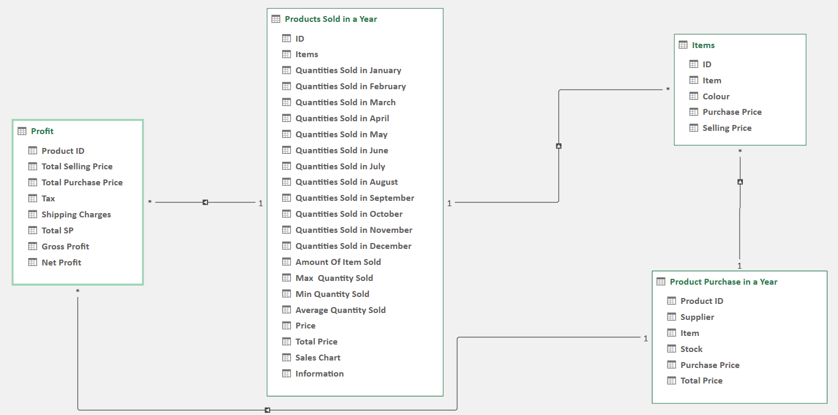
Power Pivot

Slide 20
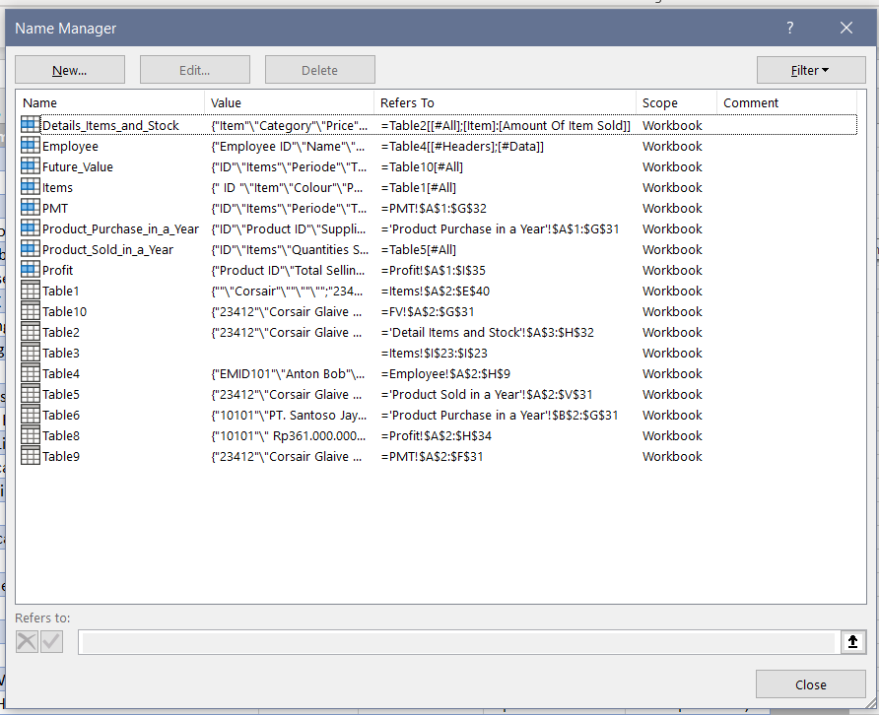
Define Name

Slide 21
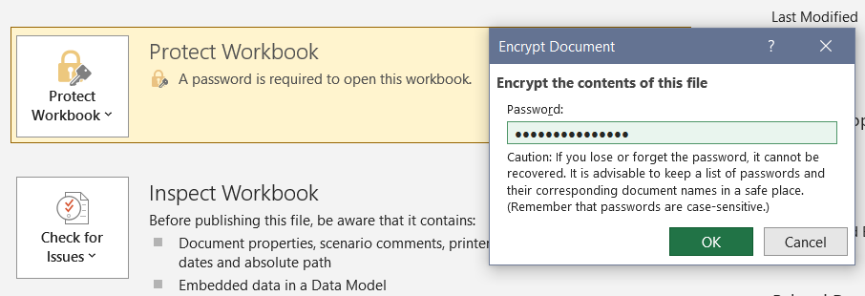
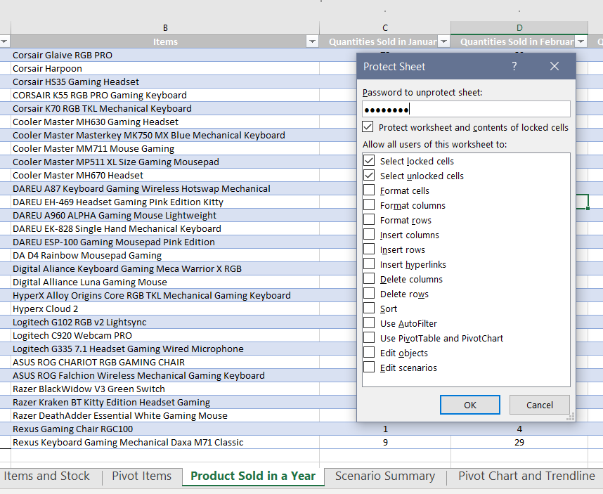
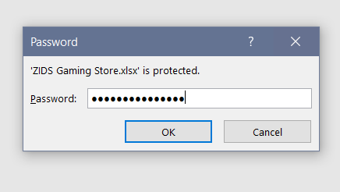
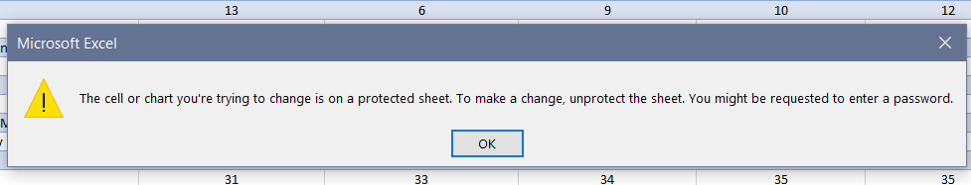

Protection
File Protection
Sheet Protection

Slide 22
THANK YOU !

